Slide 1
APP CONTROLLED PICK AND PLACE ROBOTIC VEHICLE
Mentor- Dr. Swati Vaid
Presented by Paras Kushwaha, Prabhat Kumar Tiwari, Preeti Bisht, Sachin Sharma and Suraj Singh

Slide 2
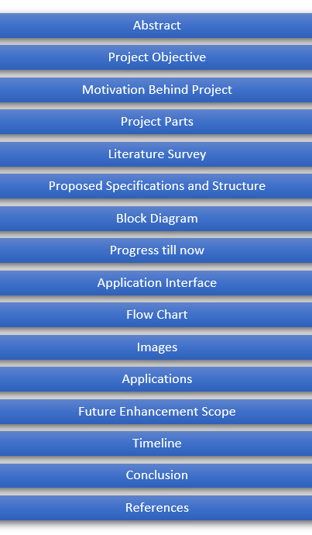
Presentation Flow

Slide 3
Abstract
Today technology is developing in the same direction in line with rapidly increasing human needs. The work done to meet these needs makes life easier every day. Robot arm works with an outside user or by performing predetermined commands.
Nowadays, the most developed field of robot arms in every field is the industry and medicine sector. Designed and realized in the project, the robot arm has the ability to move in 4 axis direction with 5 servo motors. Thanks to the holder, you can take the desired material from one place and carry it to another place, and also mix it with the material it receives.
While doing this, robot control is provided by connecting to the android application via Bluetooth module connected to Arduino Uno microcontroller.

Slide 4


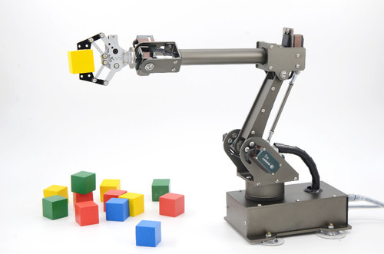
Objective
The objective of the project is to pick things from one place and place them on desired location with the help of a moving robot with an arm.

Slide 5
Motivation Behind Project?
With the thought of helping old and disabled
people who aren’t able to pick things up on their
own or have a hard time doing that.
This project can help these people picking up
things and placing them with minimal efforts.
Societal Cause
The idea emerged with the thought of helping old and disabled people.

Slide 6
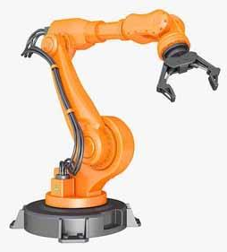
Project Parts
Project contains two types of parts-
Electronic Parts
Mechanical Parts
Mechanical arm, chassis
Note:
Electronic part is the part of the project where electronic components and circuitry work all together with the mechanical structure.

Slide 7
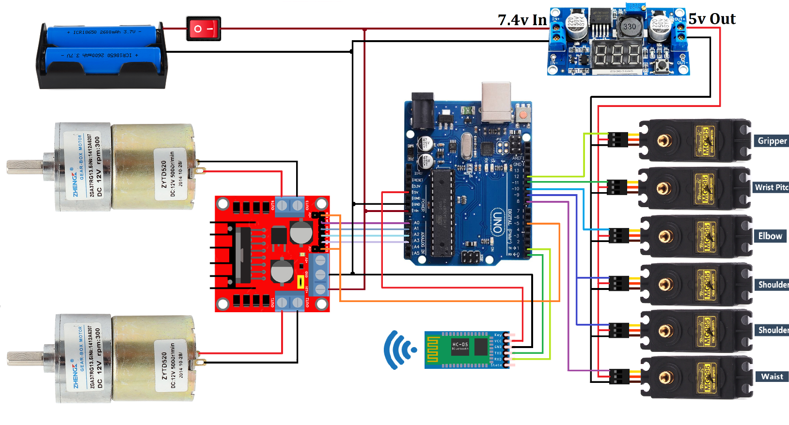
Electronic Components Used
CIRCUIT DIAGRAM
L298 Motor Driver
MG995 Servo Motor x 6
12V DC Gear Motor x 2
hc-05 Bluetooth Module
DC to DC Buck Converter

Slide 8
Literature Survey
[1] Design and Analysis of Pick and Place Robot by S. Mohanavelan¹ , M. Madhan Kumar² , K. Mohanprabhu³ , M. Narendhiran⁴ , B. Om Adhavan⁵
[2] Design of Pick and Place Robot by S. Sentil Kumar
[3] Implementation of Pick and Place Robot by R.Neeraja¹, Dr. Sanjay Dubey², S.B.Arya³, Neeraj Moota⁴
[4] Design and Fabrication of RF-Controlled Pick and Place Robotic Vehicle by Monsuru Abolade Adeagbo¹ , Ifeoluwa David Solomon² , Peter Olalekan Idowu³ , John Adedapo Ojo⁴
[5] Development of Pick and Place Robot in Agriculture by Srinivasa Nayaka K R¹ , Dr. Mallikarjuna.C ²

Slide 9
[6] Voice controlled Camera Assisted Pick and Place Robot Using Raspberry Pi by Muneera Altayeb¹ , Amani Al-Ghraibah²
[7] Android Phone Controlled Robot Using Bluetooth by Arpit Sharma¹ , Reetesh Verma² , Saurabh Gupta³ and Sukhdeep Kaur Bhatia⁴
[8] ANDROID PHONE CONTROLLED BLUETOOTH ROBOTIC VEHICLE by Luv Sharma¹, Nidhi Mahawar², Nikita Meena³, Nikhil Chopra⁴, Ajay Bhardwaj⁵, Abhishek Gupta⁶
[9] Generic Development of Bin Pick-and-Place System Based on Robot Operating System by CHING-CHANG WONG ^{1,2}, CHI-YI TSAI ^{1,2}, (Senior Member, IEEE), REN-JIE CHEN² , SHAO-YU CHIEN ² , YI-HE YANG ² , SHANG-WEN WONG ² , AND CHUN-AN YEH ²
[10] Voice-based direction control of a robotic vehicle through User commands by Mohammadibrahim Korti¹ , Girish B. Shettar² , Ganga A Hadagali¹ , Shashidhar Shettar³ , Shailesh Shettar³

Slide 10
[11] Design Analysis of a Remote Controlled “Pick and Place” Robotic Vehicle by ¹B.O.Omijeh and ²R.Uhunmwangho
[12] OBSTACLE AVOIDANCE ROBOTIC VEHICLE USING ULTRASONIC SENSOR, ARDUINO CONTROLLER by R.VAIRAVAN^{[1]}, S.AJITH KUMAR^{[2]}, L.SHABIN ASHIFF^{[3]} , C.GODWIN JOSE ^{[4]}
[13] Remote Controlled Pick and Place Robot by Meenakshi Prabhakar¹* , Valenteena Paulraj¹ , Dhusyant Arumukam Karthi Kannappan¹ , Joshuva Arockia Dhanraj¹ , Deenadayalan Ganapathy¹
[14] Robotic Arm Control Using Arduino by Rajashekar K¹ , Hanumantha Reddy² , Ruksar Begum T K³ , Shaheena Begum⁴ , Syeda Ziya Fathima⁵ , Saba Kauser⁶
[15] SMART PHONE BASED ROBOTIC CONTROL FOR SURVEILLANCE APPLICATIONS by M. Selvam

Slide 11
[16] Android based robot implementation for pick and retain of objects by Ranjith Kumar Goud and B. Santosh Kumar.
[17] IoT developed Wi-Fi Controlled Rover with Robotic Arm Using NodeMCU by Gaurav Singh¹, Ashirwad Kumar Singh², Anurag Yadav³, Indu Bhardwaj⁴, Dr. Usha Chauhan⁵

Slide 12
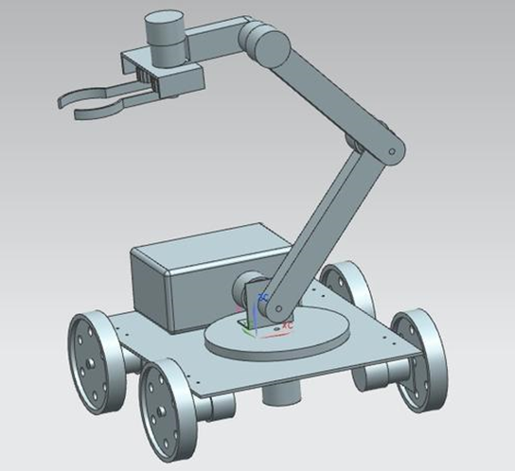
Proposed Specifications and Structure
Overview of the arm:
Degrees of freedom: 5
Payload capacity: 180gm
Joint speed (approximate): 40-60 rpm
Base spin: 180 degrees
Shoulder base spin: 180 degrees
Elbow pitch: 180 degrees
Finger opening (Max): 10cm

Slide 13
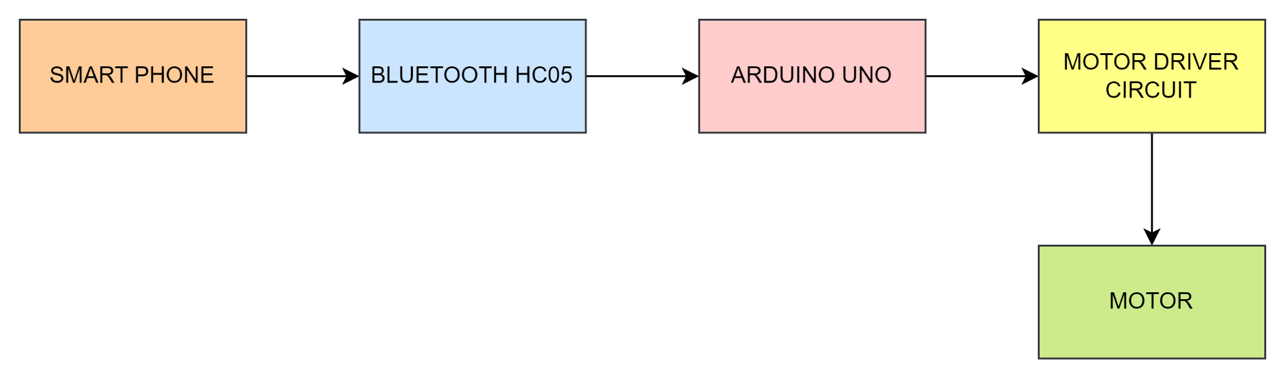
Block Diagram

Slide 14

Progress till now…
Progress | Status | Details
Initial level coding for Arduino |  | Arduino IDE
App Interface |  | Using MIT App Inventor
Hardware |  | Surface and Arm
Updates regarding the project
https://github.com/prettymess25/pickandplacerobot

Slide 15
Link for the initial code:
https://github.com/prettymess25/pickandplacerobot/blob/main/Robotic_Arm_Vehicle1.ino
Link to download the application:
https://github.com/prettymess25/pickandplacerobot/raw/main/Robotic_Arm_Vehicle%20(1).apk
Link for the design specifications:
http://ai2.appinventor.mit.edu/#5232126862426112

Slide 16
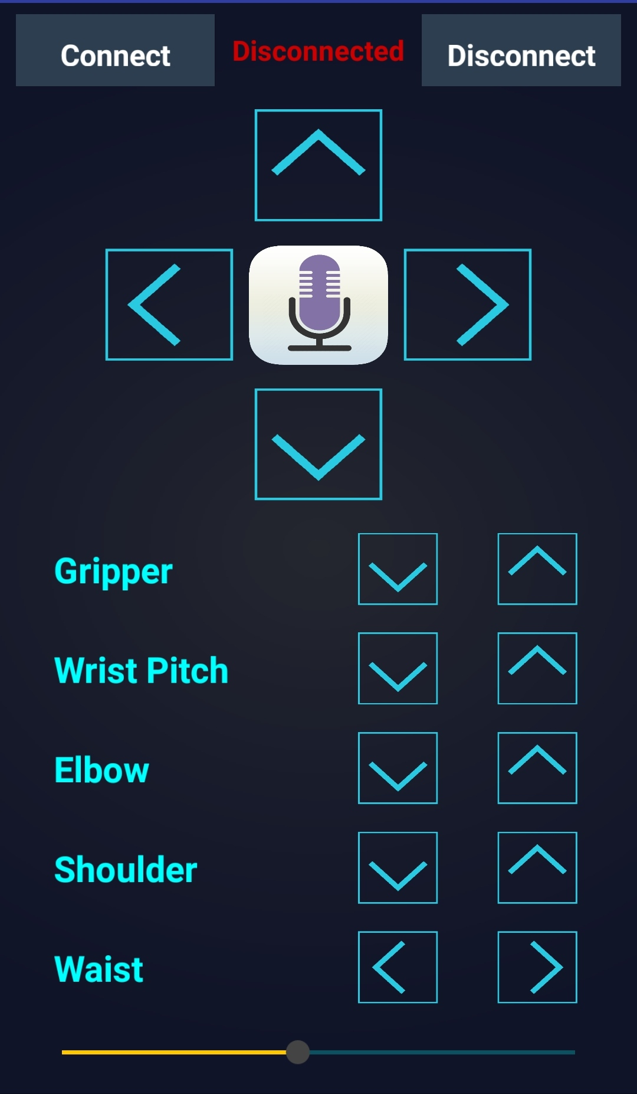
Application Interface
Features
Forward
Backward
Left
Right
Gripper
Wrist Pitch
Elbow
Shoulder
Waist

Slide 17
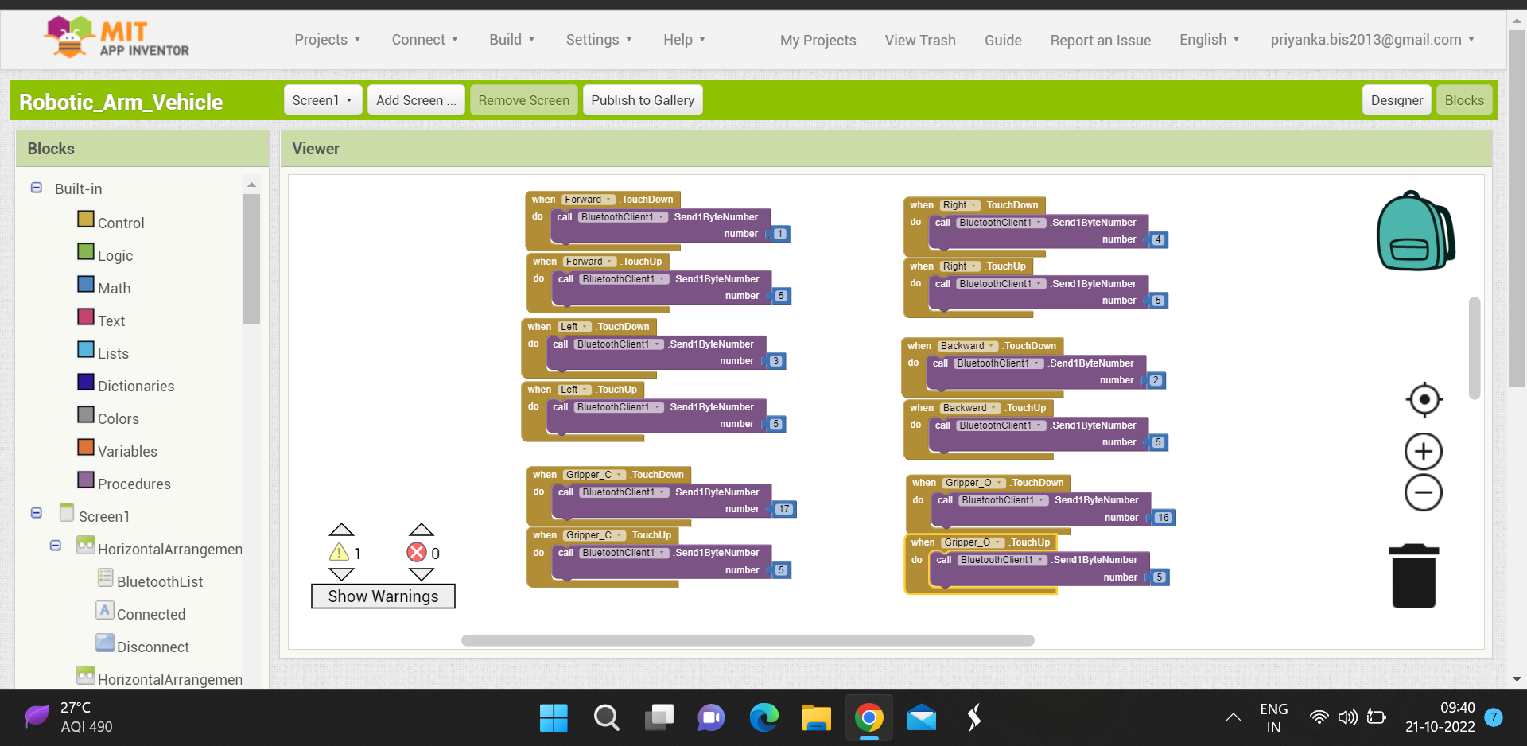

Slide 18
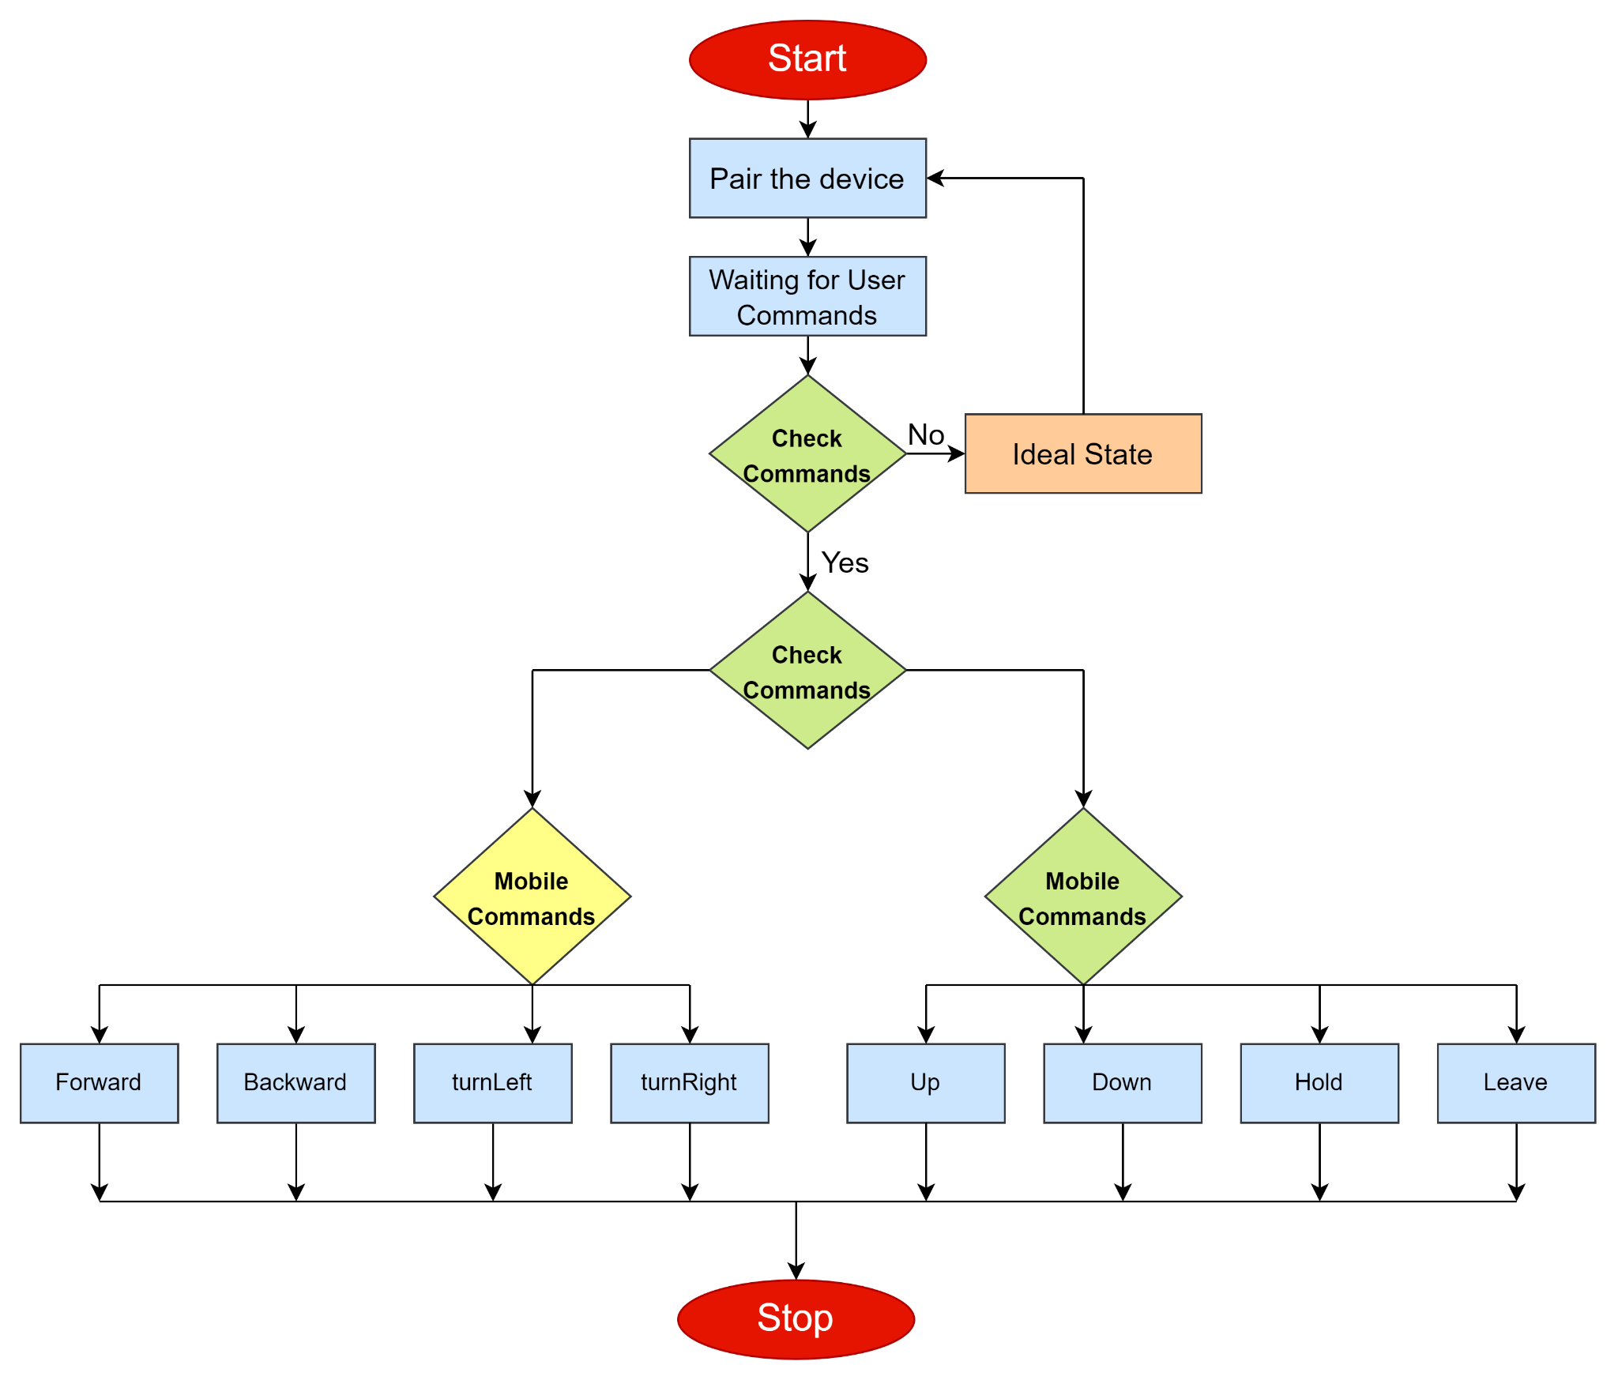
Flow Chart of App

Slide 19
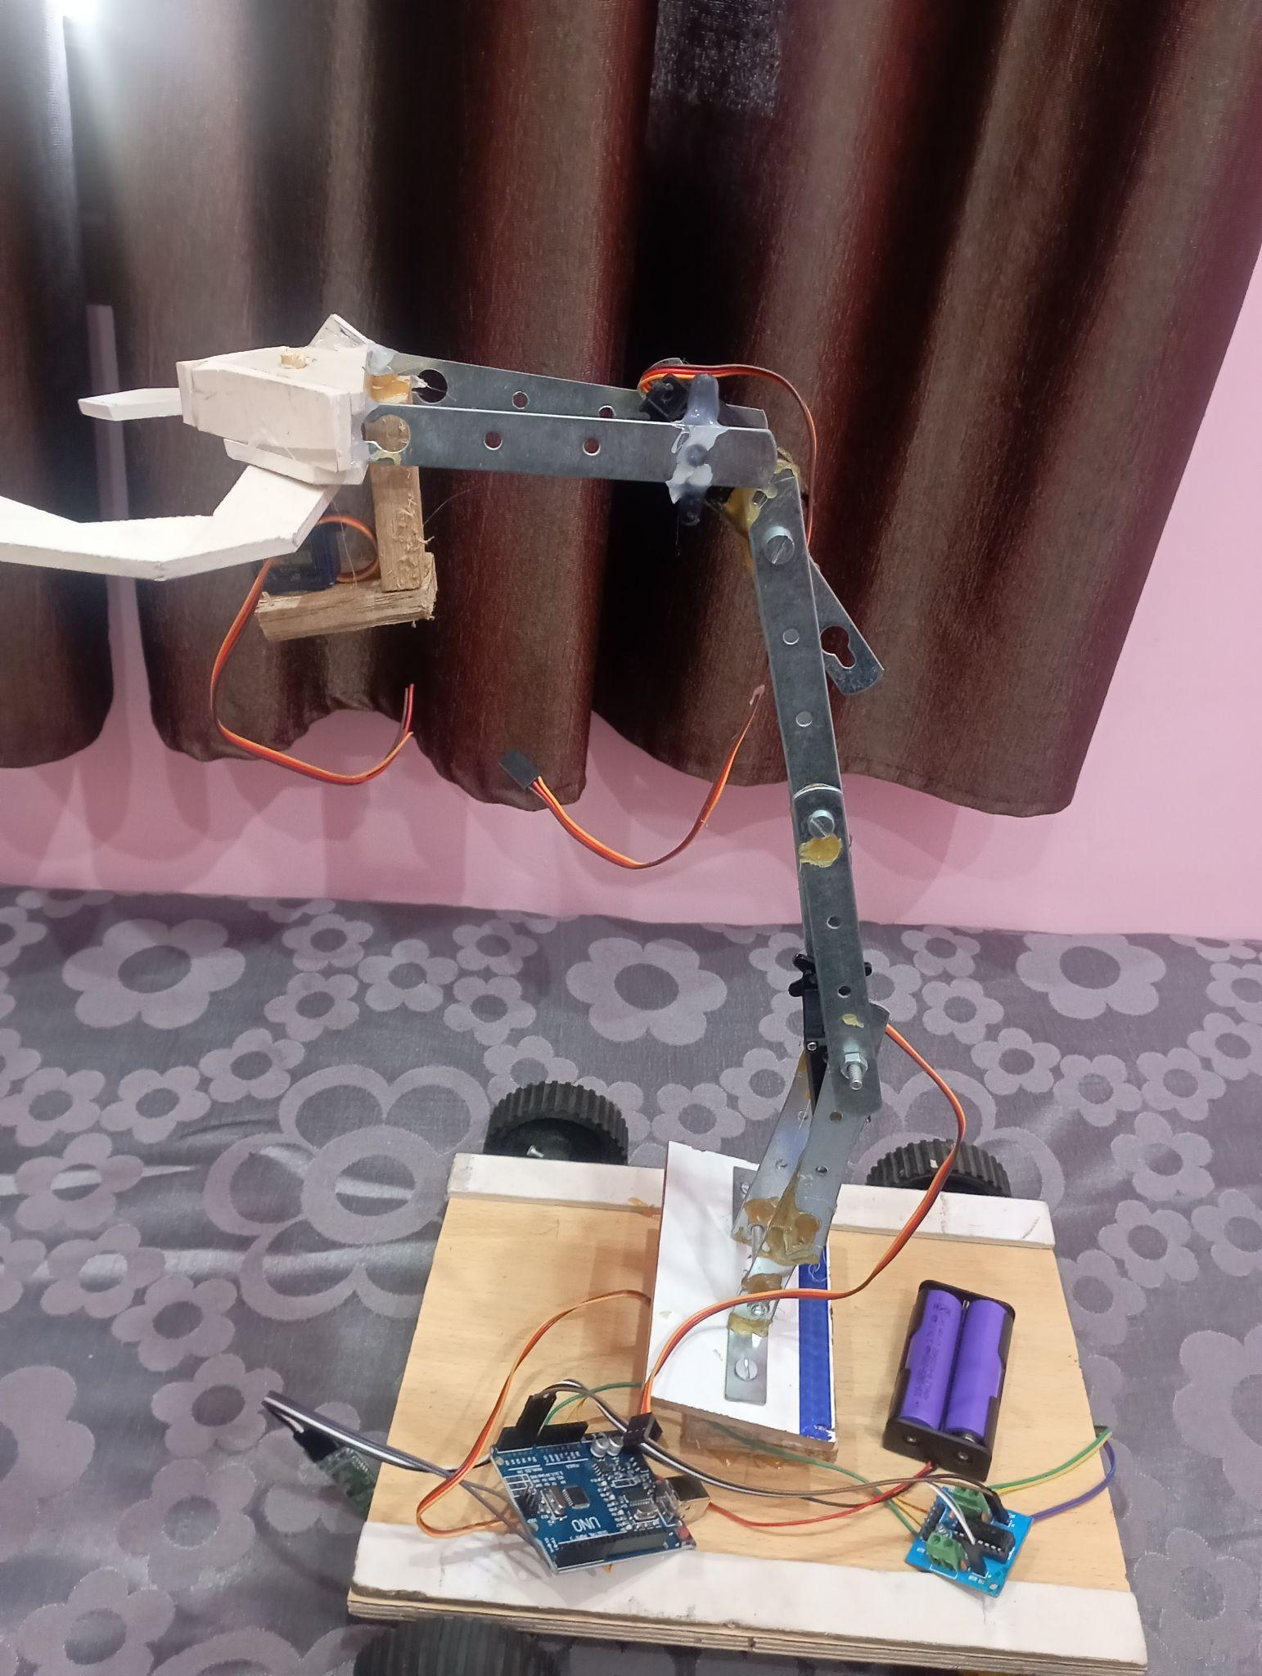
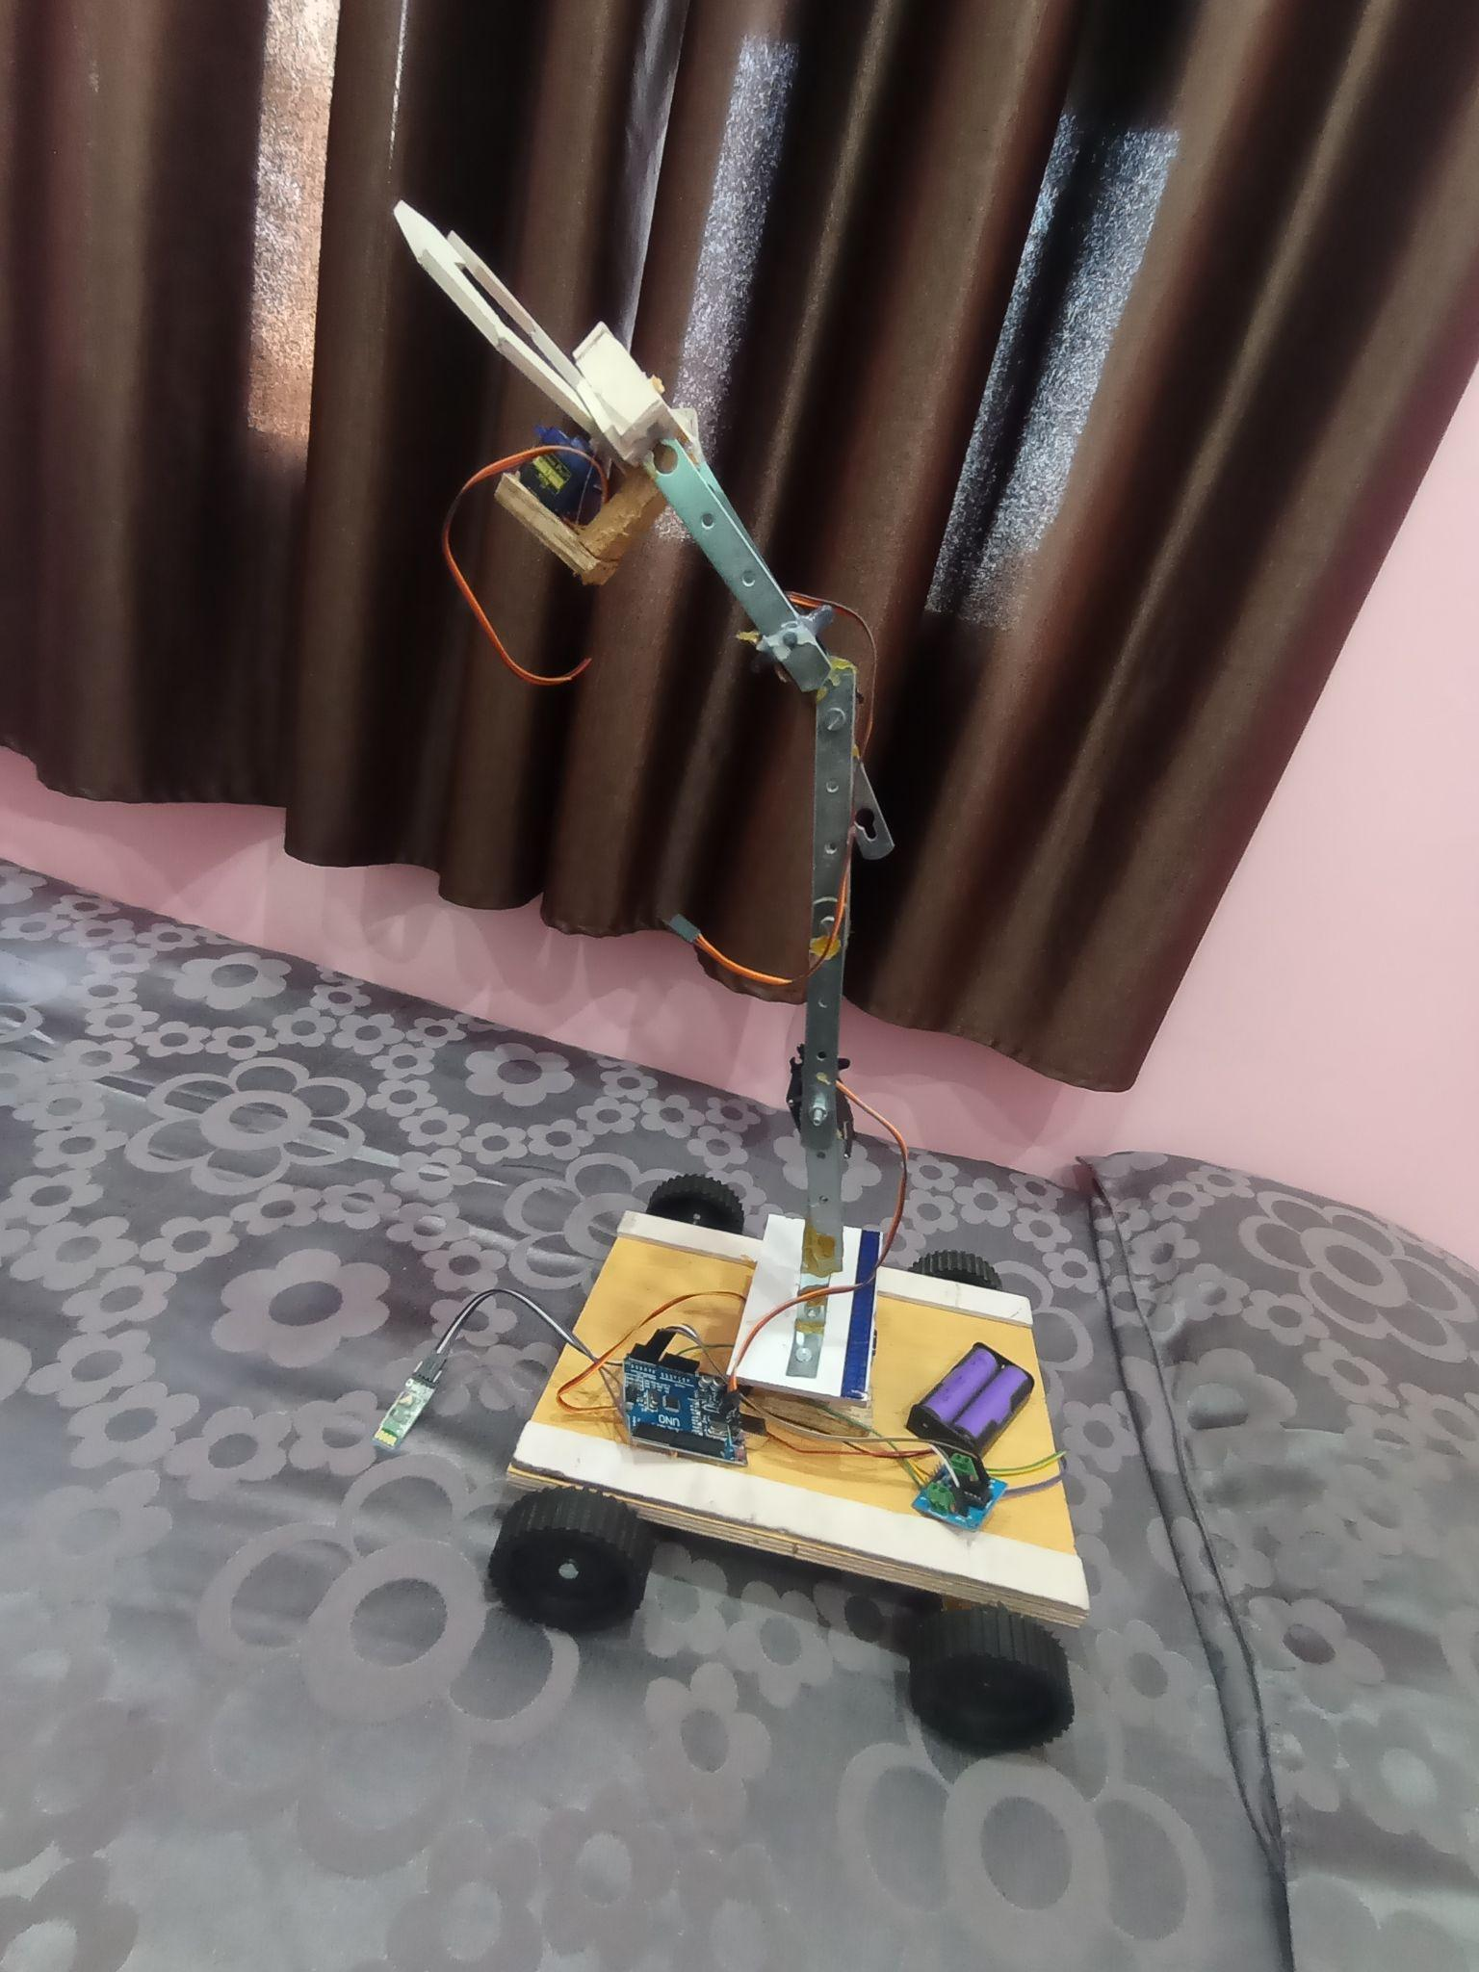

Slide 20
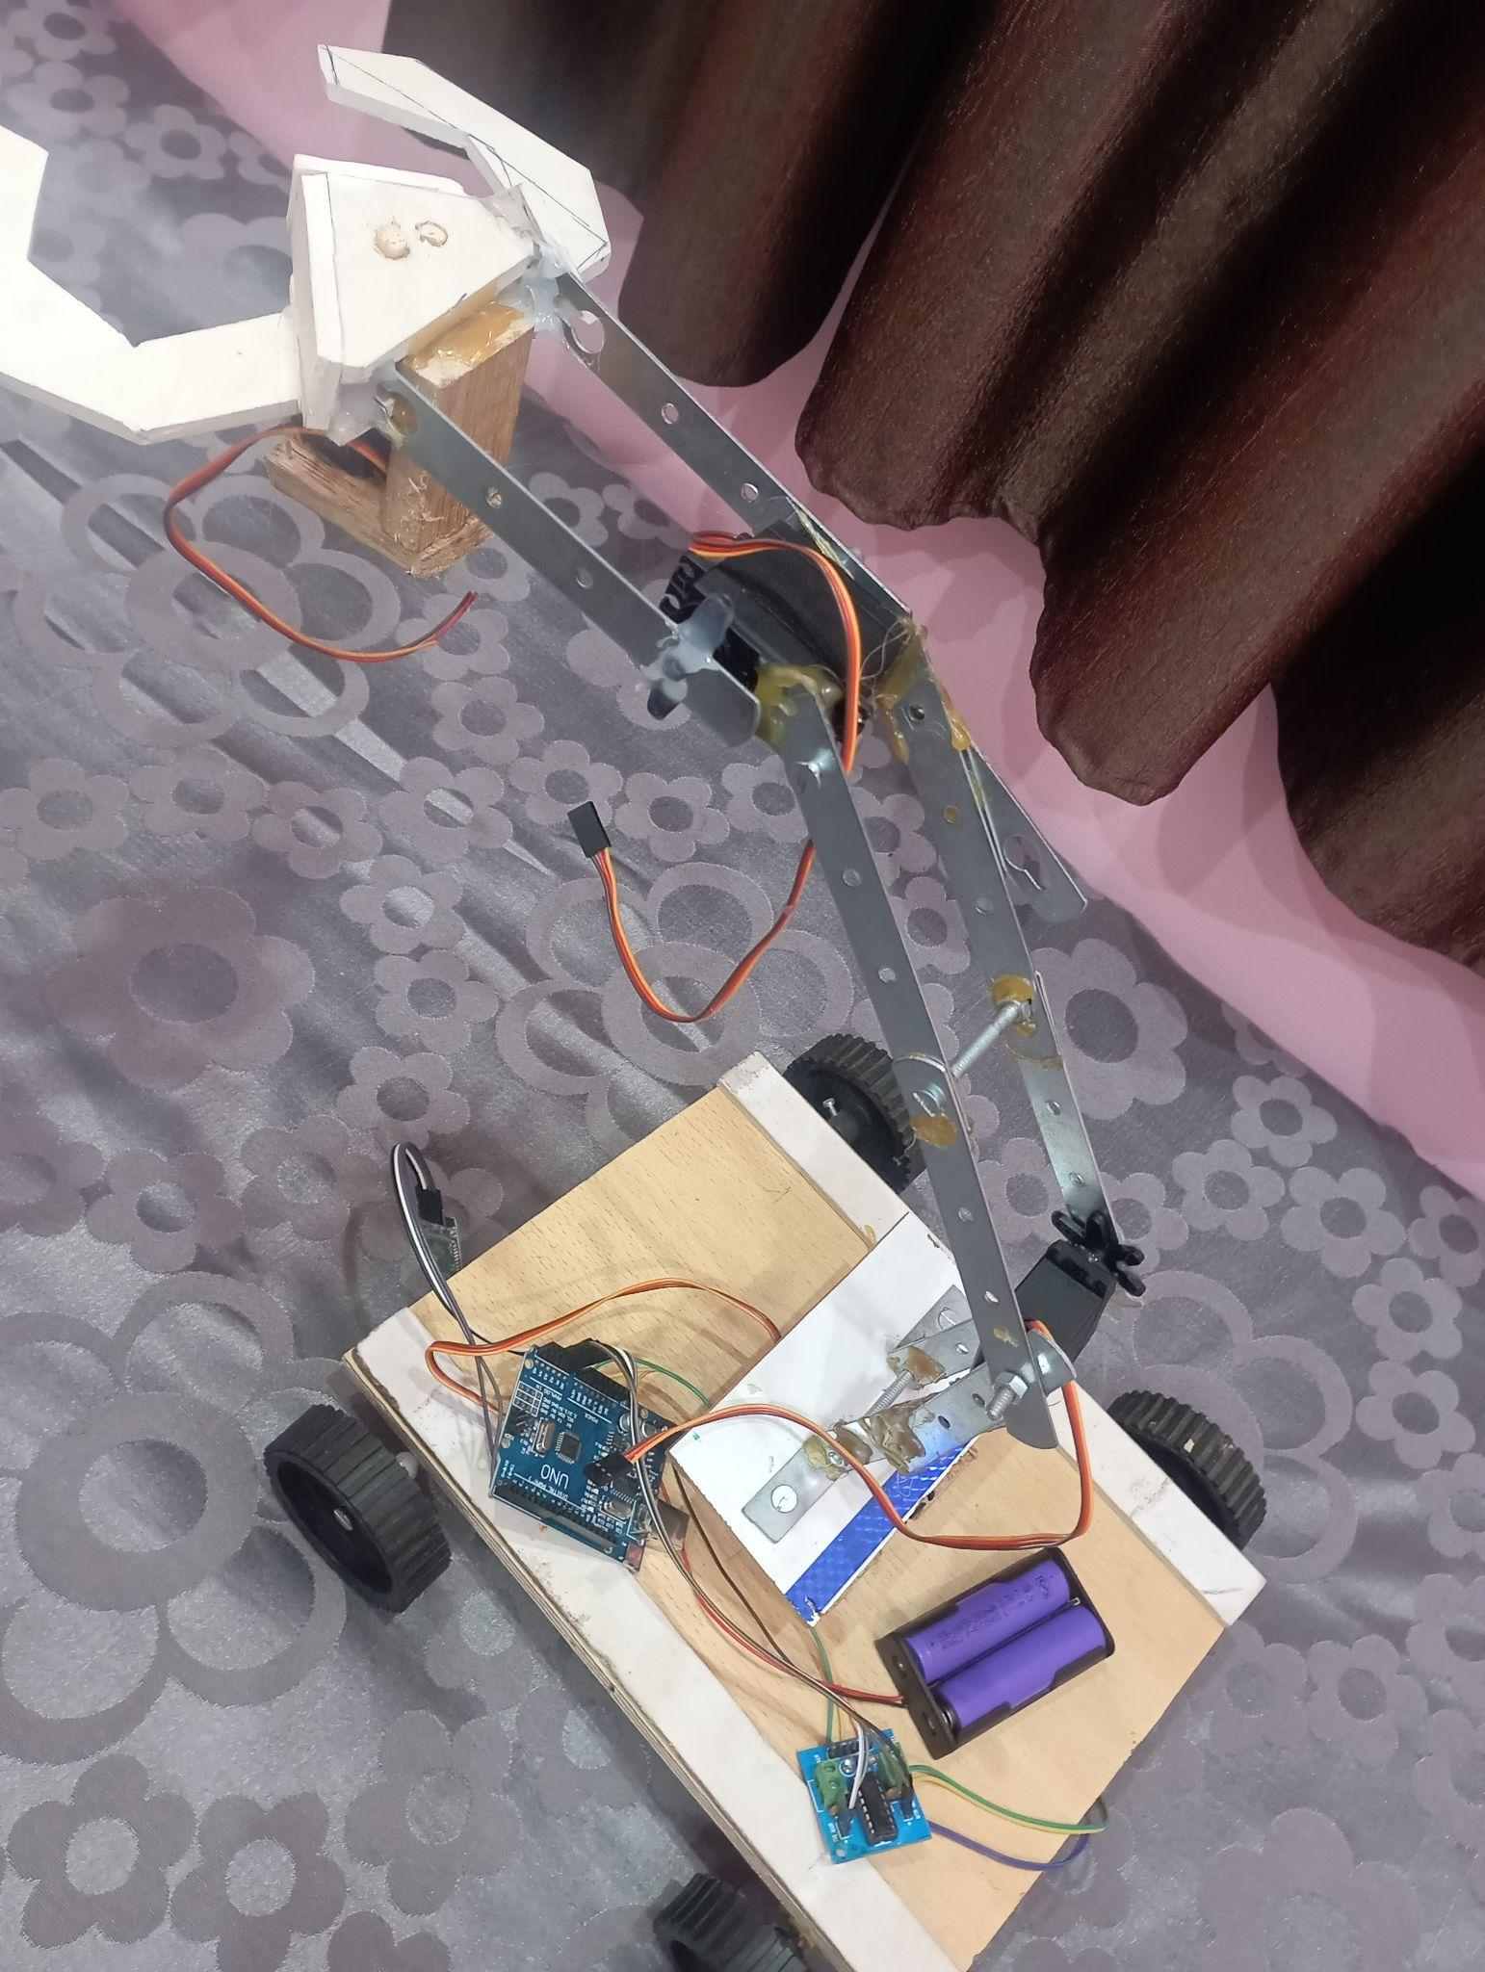
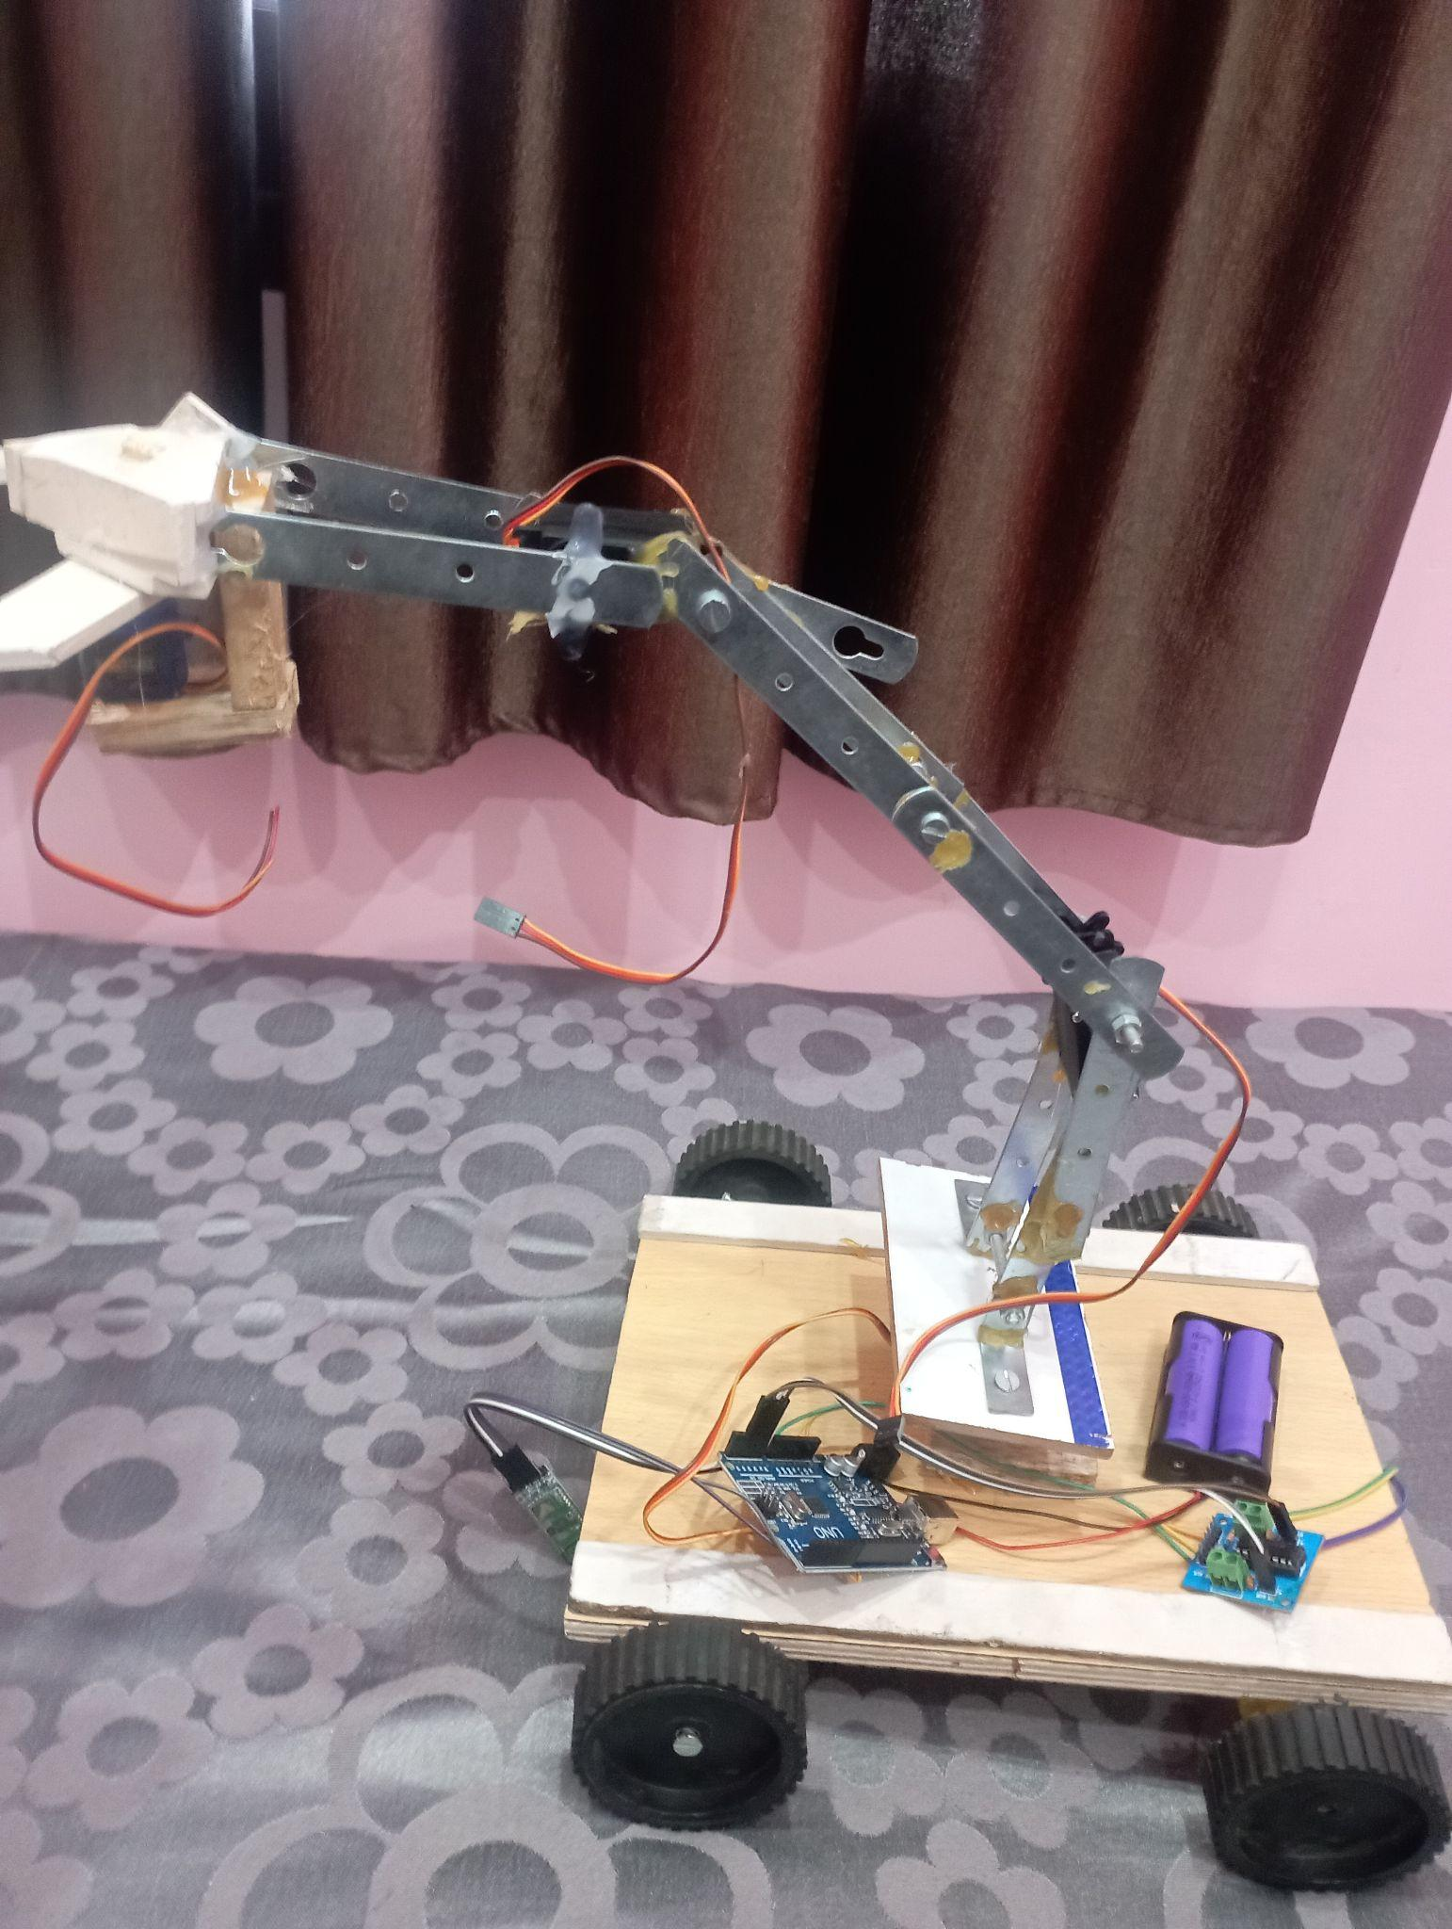

Slide 21
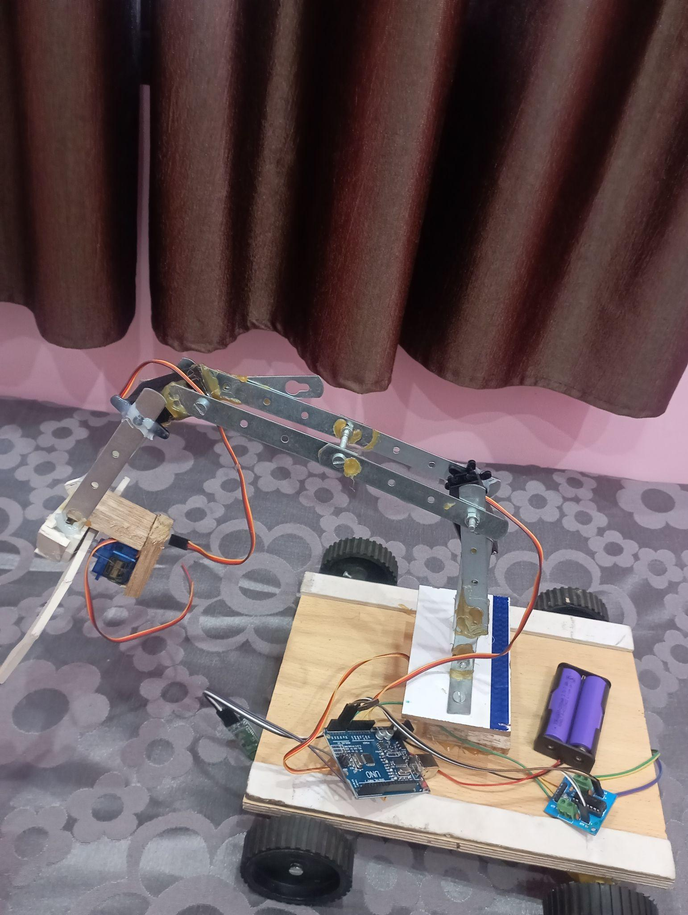
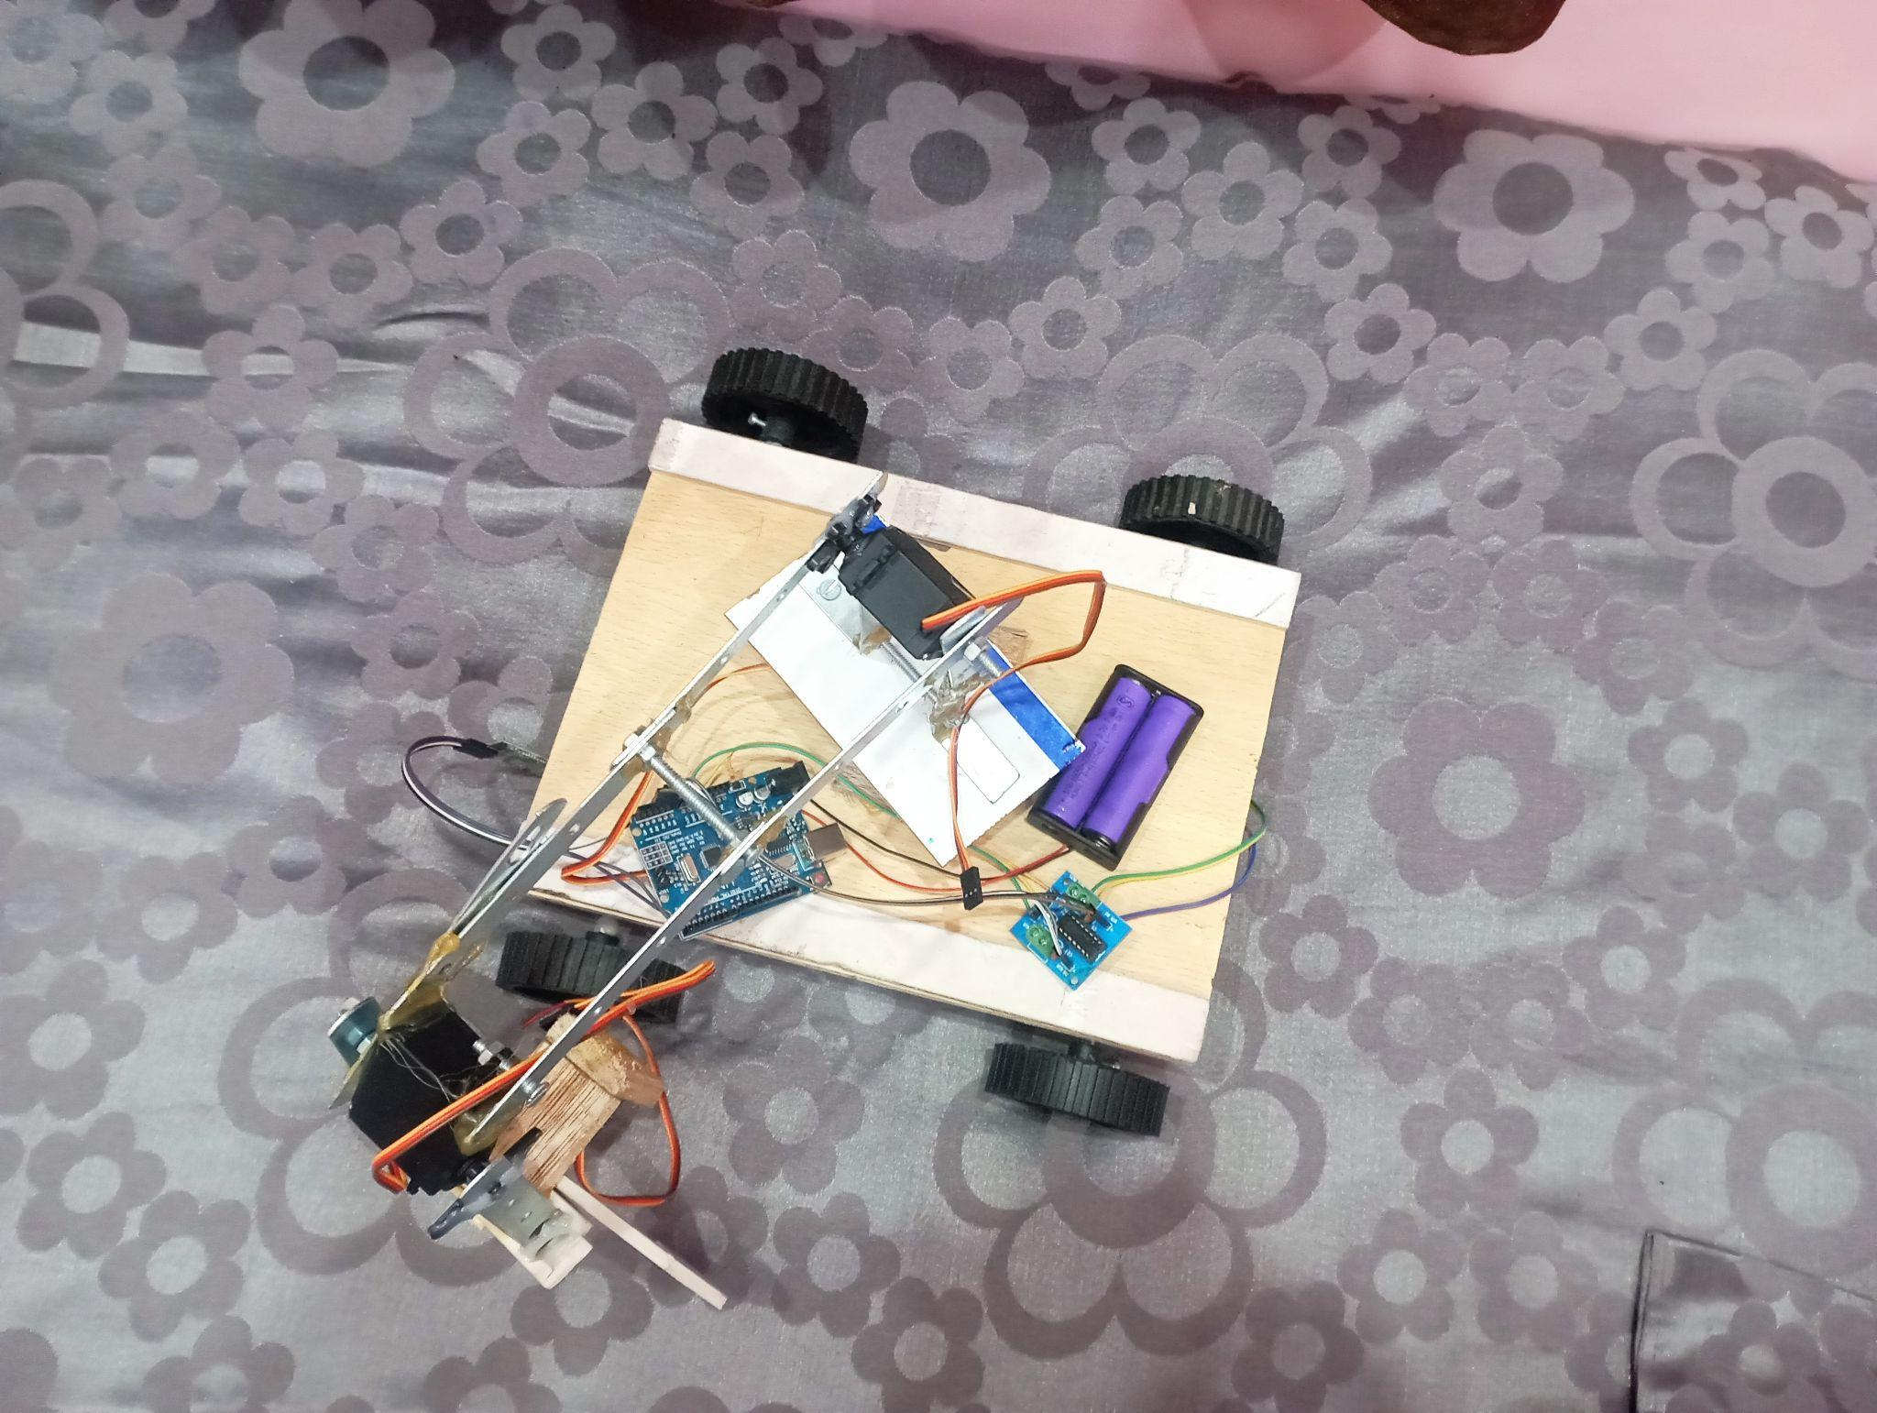

Slide 22
Applications…
Mainly focuses on helping old and disabled people.
Can be used by common people for certain day to day activity.
Can be used in industries and offices with certain modifications according to needs.

Slide 23
Future Enhancement Scope
With high budget, the project has potential of enhancement in various ways.
Use of strong and expensive material to increase the limit of weight it can pick and hold.
More accuracy and range.
Advanced features can be introduced according to requirements.
Surface to height movement can be achieved.
Sensors for obstacle tackling and movement on it’s own.
Can introduce an AI.

Slide 24
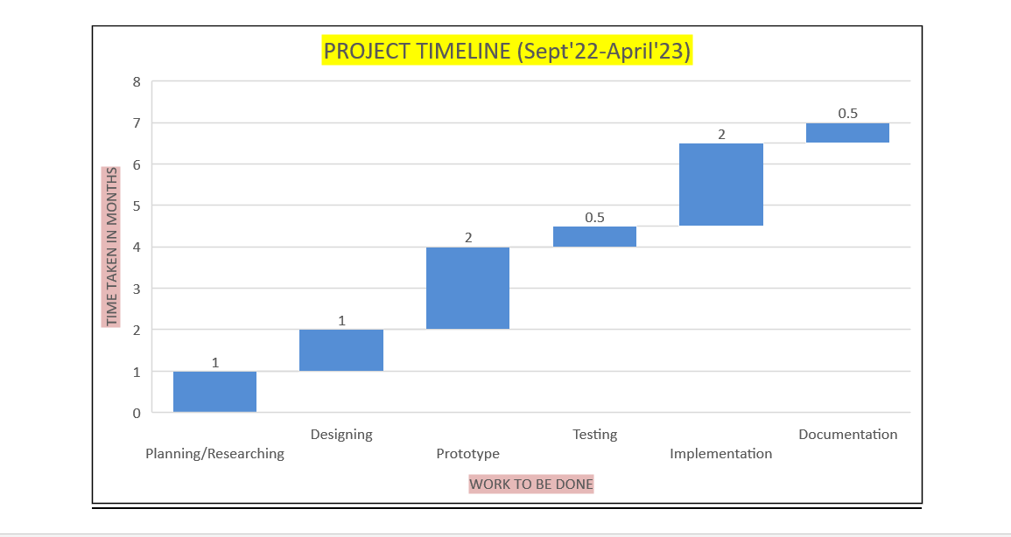
Timeline of Project

Slide 25
Conclusion
Pick and place robot can be really helpful for old and disabled people.
The cost is estimated to be around Rs. 8000 and can be reduced further with enhancements.
It can serve multiple purposes with enhancements according to needs.

Slide 26
References
1. S. Mohanavelan¹ , M. Madhan Kumar² , K. Mohanprabhu³ , M. Narendhiran⁴ , B. Om Adhavan⁵ (2019) ‘Design and Analysis of Pick and Place Robot’ International Journal of Engineering Science and Computing, March 2019 Volume 9 Issue No.3
2. S. Sentil Kumar (2015) ‘Design of Pick and Place Robot’ International Journal of Advanced Research in Electrical, Electronics and Instrumentation Engineering Vol. 4, Issue 6, June 2015
3. R.Neeraja¹, Dr. Sanjay Dubey², S.B.Arya³, Neeraj Moota⁴ (2018) ‘ Implementation of Pick and Place Robot’ IJCRT | Volume 6, Issue 2 April 2018
4. Monsuru Abolade Adeagbo¹ , Ifeoluwa David Solomon² , Peter Olalekan Idowu³ , John Adedapo Ojo⁴ (2021) ‘Design and Fabrication of RF-Controlled Pick and Place Robotic Vehicle’ International Journal of Scientific Engineering and Science Volume 5, Issue 9, pp. 18-23, 2021.

Slide 27
5. Srinivasa Nayaka K R¹ , Dr. Mallikarjuna.C (2021) ‘Development of Pick and Place Robot in Agriculture’ IJO -INTERNATIONAL JOURNAL OF MECHANICAL AND CIVIL ENGINEERING Volume 4| Issue 08| August | 2021
6. Muneera Altayeb¹ , Amani Al-Ghraibah² (2022) ‘Voice controlled Camera Assisted Pick and Place Robot Using Raspberry Pi’ Indonesian Journal of Electrical Engineering and Informatics (IJEEI) Vol. 10, No. 1, March 2022, pp. 51~59
7. Arpit Sharma¹ , Reetesh Verma² , Saurabh Gupta³ and Sukhdeep Kaur Bhatia⁴ (2014) ‘Android Phone Controlled Robot Using Bluetooth’ International Journal of Electronic and Electrical Engineering. ISSN 0974-2174, Volume 7, Number 5 (2014), pp. 443-448
8. Luv Sharma¹, Nidhi Mahawar², Nikita Meena³, Nikhil Chopra⁴, Ajay Bhardwaj⁵, Abhishek Gupta⁶ (2022) ‘ANDROID PHONE CONTROLLED BLUETOOTH ROBOTIC VEHICLE’ International Research Journal of Modernization in Engineering Technology and Science Volume:04/Issue:05/May-2022
9. CHING-CHANG WONG ^{1,2}, CHI-YI TSAI ^{1,2}, (Senior Member, IEEE), REN-JIE CHEN² , SHAO-YU CHIEN ² , YI-HE YANG ² , SHANG-WEN WONG ² , AND CHUN-AN YEH ² (2022) ‘Generic Development of Bin Pick-and-Place System Based on Robot Operating System’ IEEE VOLUME 10, 2022

Slide 28
10. Mohammadibrahim Korti¹ , Girish B. Shettar² , Ganga A Hadagali¹ , Shashidhar Shettar³ , Shailesh Shettar³ (2022) ‘Voice-based direction control of a robotic vehicle through User commands’ International Research Journal on Advanced Science Hub 2582-4376 Vol. 04, Issue 03 March 2022
11. ¹B.O.Omijeh and ²R.Uhunmwangho (2014) ‘Design Analysis of a Remote Controlled “Pick and Place” Robotic Vehicle’ International Journal of Engineering Research and Development e-ISSN: 2278-067X, p-ISSN: 2278-800X, www.ijerd.com Volume 10, Issue 5 (May 2014), PP.57-68
12. R.VAIRAVAN^{[1]}, S.AJITH KUMAR^{[2]}, L.SHABIN ASHIFF^{[3]} , C.GODWIN JOSE ^{[4]} (2022) ‘OBSTACLE AVOIDANCE ROBOTIC VEHICLE USING ULTRASONIC SENSOR, ARDUINO CONTROLLER’ International Research Journal of Engineering and Technology (IRJET) Volume: 05 Issue: 02 | Feb-2018
13. Meenakshi Prabhakar¹* , Valenteena Paulraj¹ , Dhusyant Arumukam Karthi Kannappan¹ , Joshuva Arockia Dhanraj¹ , Deenadayalan Ganapathy¹ (2021) ‘Remote Controlled Pick and Place Robot’ IOP Conference Series: Materials Science and Engineering 2021
14. Rajashekar K¹ , Hanumantha Reddy² , Ruksar Begum T K³ , Shaheena Begum⁴ , Syeda Ziya Fathima⁵ , Saba Kauser⁶ (2020) ‘Robotic Arm Control Using Arduino’ © 2020 JETIR June 2020, Volume 7, Issue 6

Slide 29
15. M. Selvam (2022) ‘SMART PHONE BASED ROBOTIC CONTROL FOR SURVEILLANCE APPLICATIONS’ IJRET: International Journal of Research in Engineering and Technology Volume: 03 Issue: 03 | Mar-2014
16. Ranjith Kumar Goud and B. Santosh Kumar (2014) ‘Android based robot implementation for pick and retain of objects’ Int J Eng Trends Technol (IJETT) Volume 6 Issue 3
17. Gaurav Singh¹, Ashirwad Kumar Singh², Anurag Yadav³, Indu Bhardwaj⁴, Dr. Usha Chauhan⁵ (2020) ‘IoT developed Wi-Fi Controlled Rover with Robotic Arm Using NodeMCU’ IEEE 2nd International Conference on Advances in Computing, Communication Control and Networking (ICACCCN)
18.https://www.pwrpack.com/what-is-a-pick-and-placerobot/#:~:text=Pick%20and%20place%20robots%20enable,a%20lot%20of%20thought%20processes
19. https://www.iqsdirectory.com/articles/automation-equipment/industrial-robots.html

